Slide 1
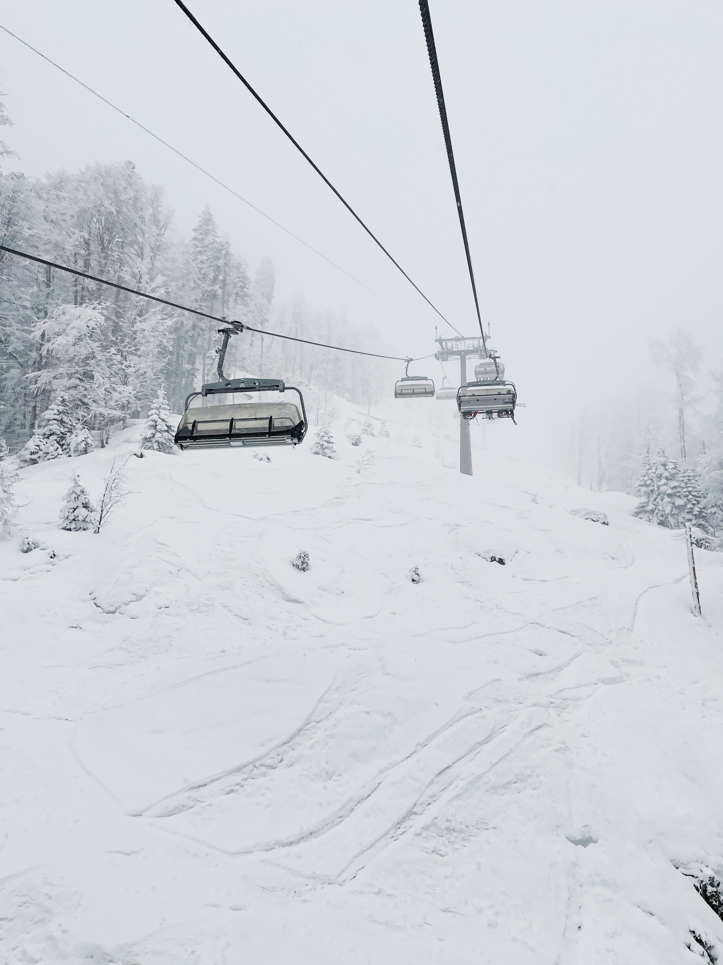

GUIDED CAPSTONE
BIG MOUNTAIN RESORT: EXECUTIVE PRESENTATION
Data Science Bootcamp

Slide 2


Problem Identification
Business Problem
Big Mountain Resort aims to increase revenue while maintaining customer satisfaction. The challenge is to find the optimal ticket pricing strategy that achieves both goals.
Hypothesis
Implementing a data-driven pricing strategy based on key facilities and features will lead to higher revenue and increased visitor attraction without compromising customer satisfaction.
Context
The resort seeks to leverage data analysis to understand the significance of different facilities in attracting visitors. The goal is to identify revenue optimization opportunities through data-driven insights.

Slide 3



Recommendation & Key Findings
Key Findings
Ticket prices vary across states, with some showing a broad range from $25 to over $100.
Montana and South Dakota exhibit low price variability and matching weekend and weekday prices.
States like North Carolina and Virginia have notably higher weekend prices compared to weekdays.
A clear trend is observed where weekend prices are higher for resorts with prices below $100.
The relationship between weekend and weekday prices in Montana is particularly relevant for Big Mountain Resort.
Big Mountain is amongst the resorts with the largest amount of skiable terrain.
Recommendation
Implement a data-driven pricing strategy that tailors ticket prices based on key facilities and features of Big Mountain Resort, to optimize revenue and enhance customer satisfaction.

Slide 4
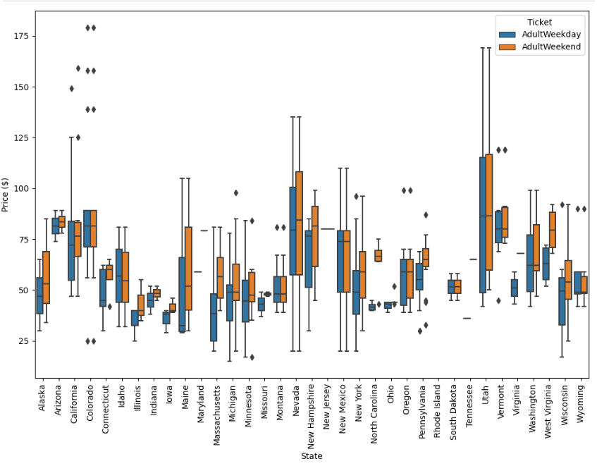
Modeling Results & Analysis
A strong correlation between ticket prices and critical attributes.
Weekend prices tend to be higher for resorts with prices below $100
Montana Case: In Montana, the distribution of weekday and weekend prices appeared equal in the boxplot.

Slide 5
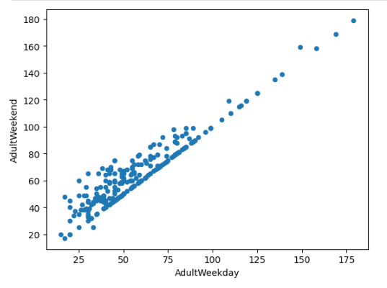
Modeling Results & Analysis
Clear Line of Equality: There is an observable trend where weekday and weekend prices are equal for some resorts.
Weekend Price Premium: Weekend prices tend to be higher than weekday prices, particularly for resorts with prices below $100.

Slide 6
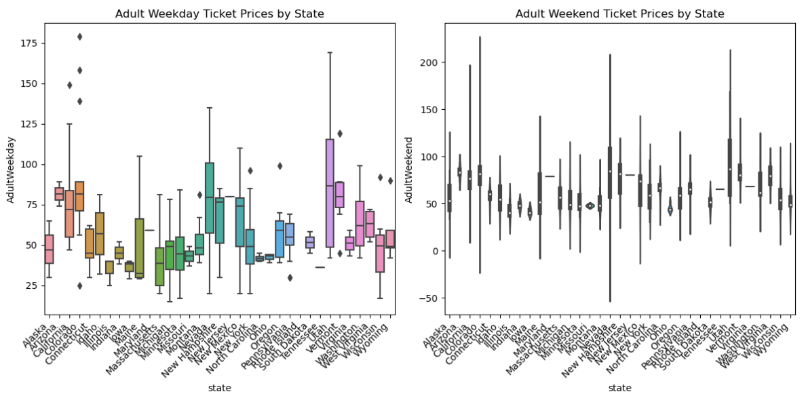
Validation in Data: In the actual data for each resort, we observe that the relationship between weekday and weekend prices is consistent with our observations.
Relevance of Big Mountain Resort: Big Mountain resort is located in Montana, and the relationship between these quantities in this state is especially relevant for our analysis.

Slide 7

Summary & Conclusion
In conclusion, our analysis of ski resort data has provided valuable insights to guide Big Mountain Resort's ticket pricing strategy.
Weekend Price Adjustment: Our analysis indicates that weekend prices, especially for resorts below $100, can be adjusted upwards to create a revenue uplift. This aligns with the trend of higher weekend prices in the industry.
Employing a data-driven pricing strategy can enhance decision-making by tailoring ticket prices based on key facilities, features, and market trends.
While optimizing revenue is crucial, maintaining customer satisfaction and affordability is equally important. Balancing these factors can lead to a sustainable and successful pricing strategy.

Slide 8

THANK
YOU

